Slide 1
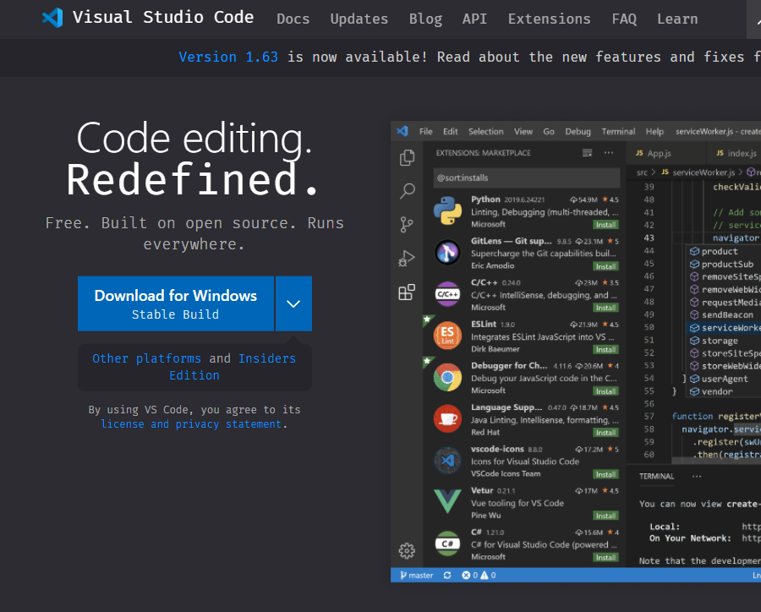
https://code.visualstudio.com/

Slide 2
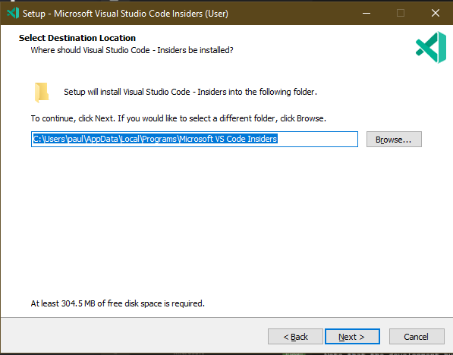
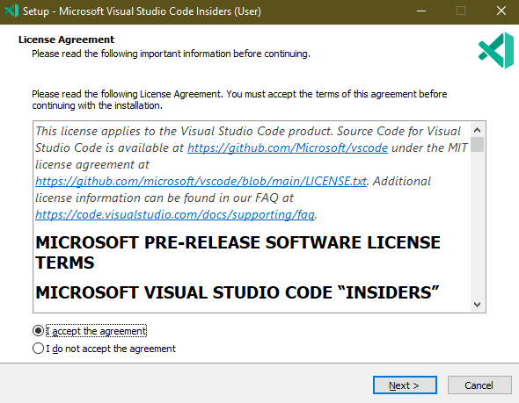
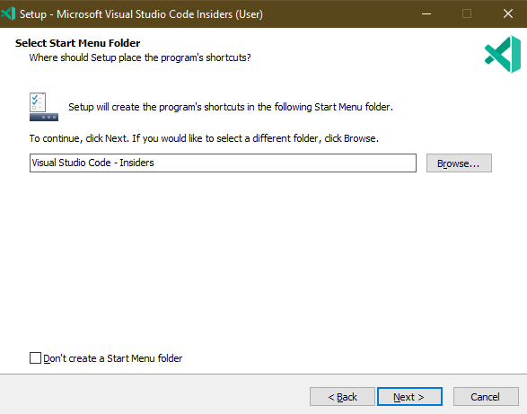
Notes:
Accept Terms and Conditions ⬇
Defaults are fine for these ➡

Slide 3
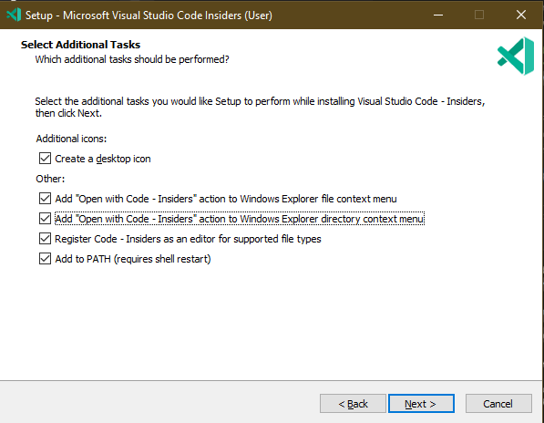
Notes:
Check everything on this screen for convenience

Slide 4
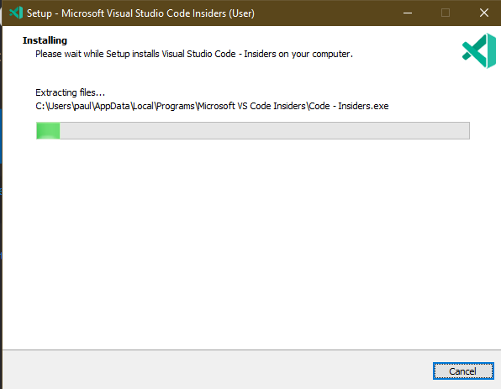
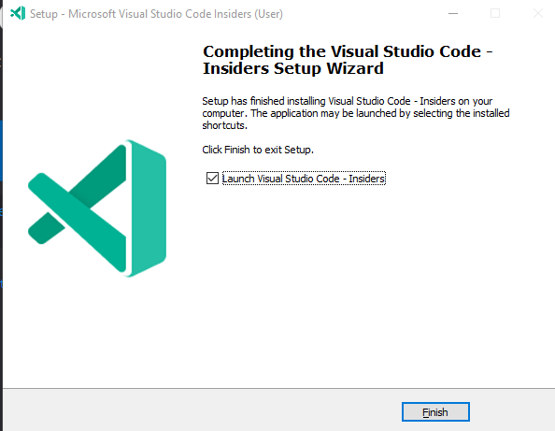
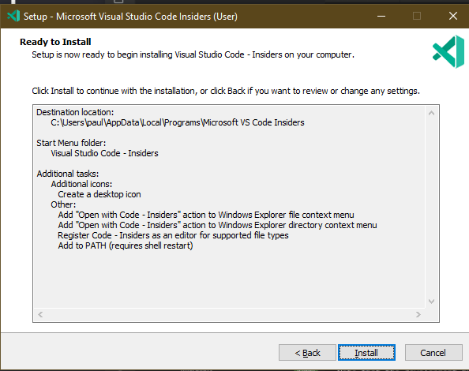
Notes:
Install it
This application generally installs very fast

Slide 5
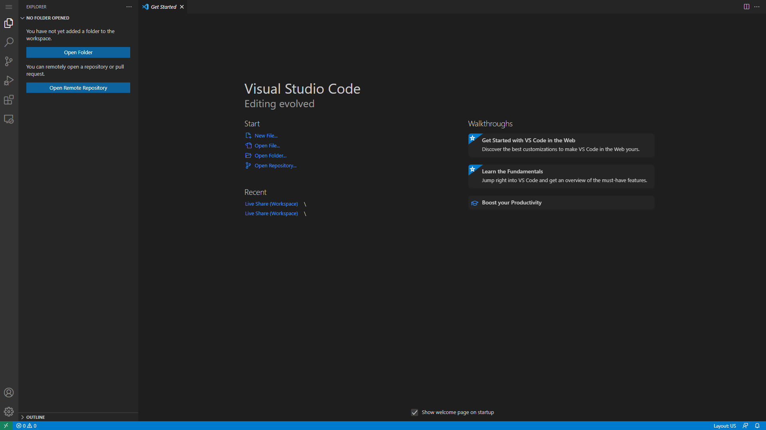
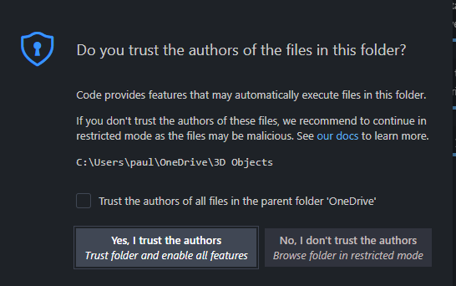
Notes:
It should look like this ⬇
Press the “Open Folder” button and choose the folder with all your SQL files in it. Press “Yes, I trust the authors.”

Slide 6
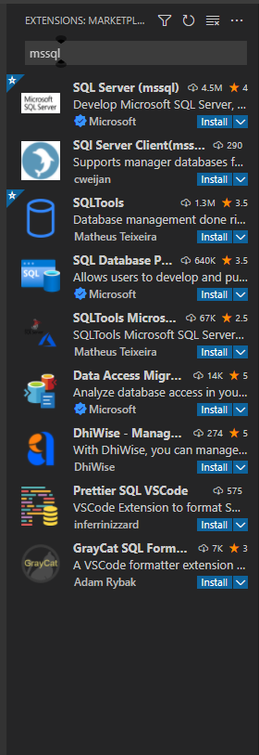

Notes:
VS Code doesn’t understand what to do with SQL files yet. Press the icon on the side that has 4 squares.
Type “mssql”
Press “Install” on the first result.
You should see this new icon, we will talk about this later.

Slide 7
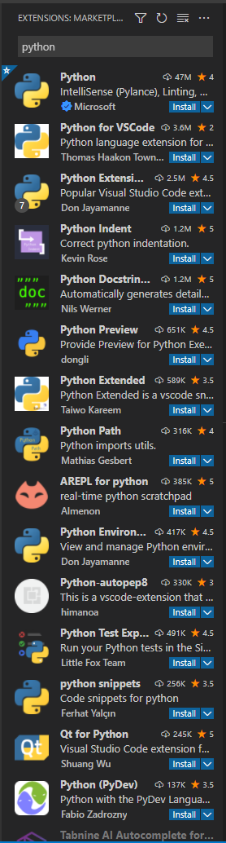
Notes:
VS Code can’t do everything out-of-the-box, however. But that’s ok! Because you can download extensions to do pretty much anything! We already downloaded the mssql extension, which is known as a “language support” extention because it adds support for SQL to VS Code.
If you want to write Python in VS Code too, you can! Hit the same button and search “Python,” then press “Install” as before. And this works for basically every programming language there is.

Slide 8
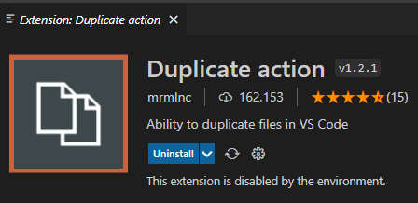
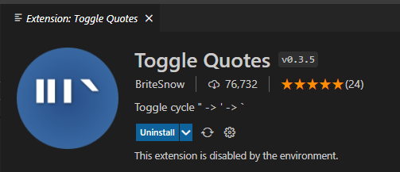
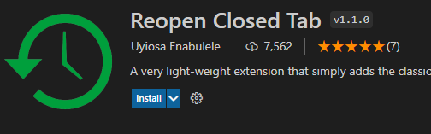
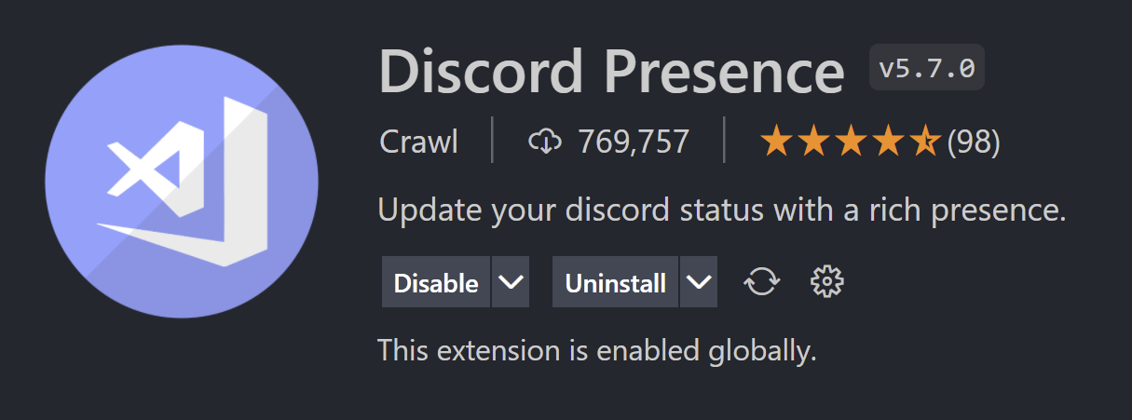
Notes:
There are also extensions to preform tasks like “Duplicate action” to duplicate files, “Toggle quotes” incase you used double quotes instead of single quotes, “Reopen Closed Tab” whenever your finger slips up, and much, much more. Whenever you’re thinking “man, I wish VS Code could do xyz,” there’s probably an extension for that. You can also look up “My favorite VSCode extensions” on YouTube, many people have made videos on this type of thing.

Slide 9
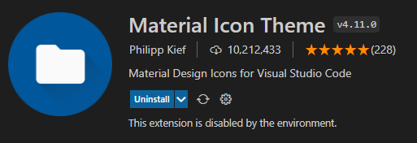
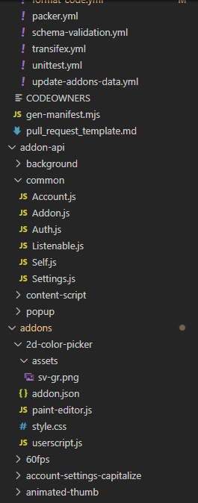
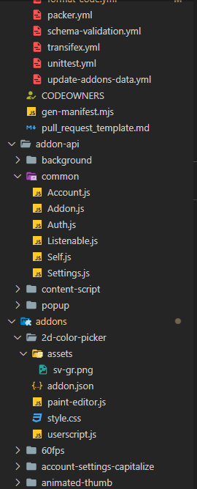
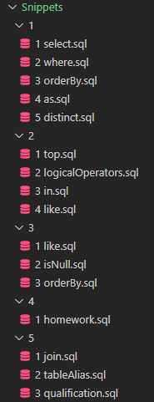
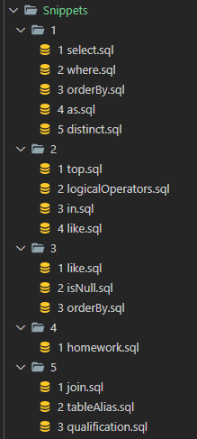
Notes:
There are also theme extensions to make your VS Code look nicer. “Material Icon Theme” changes the icons in the file selector from this to this. Of course, we only have SQL files in this folder so it isn’t very impressive. Here’s a different thing I’m working on with lots of different file types in it: from this…to this. Of course, if you don’t like it, don’t install it. That’s VS Code’s flexibility. Just don’t install too many extensions then don’t use them – it will slow down the app.

Slide 10
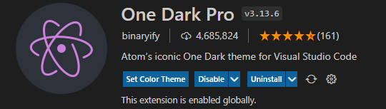
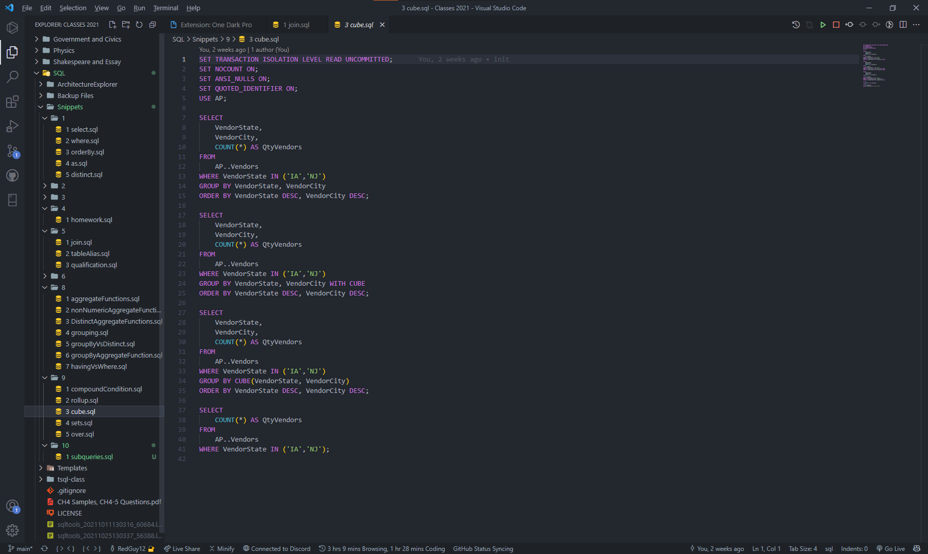
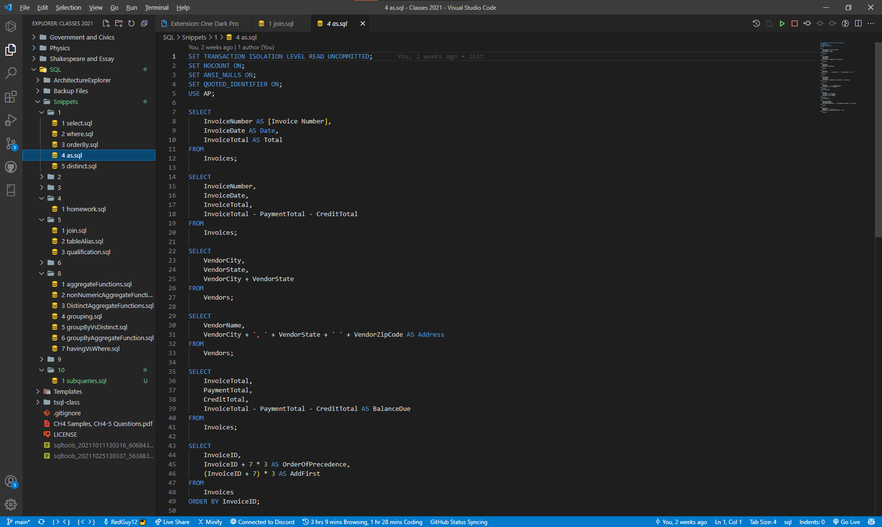
Notes:
One Dark Pro is a very popular theme for VS Code. It can take your code from looking like this…to this. There are many other themes out there, look for “My VS Code theme” on YouTube, there’s many videos on this too.

Slide 11
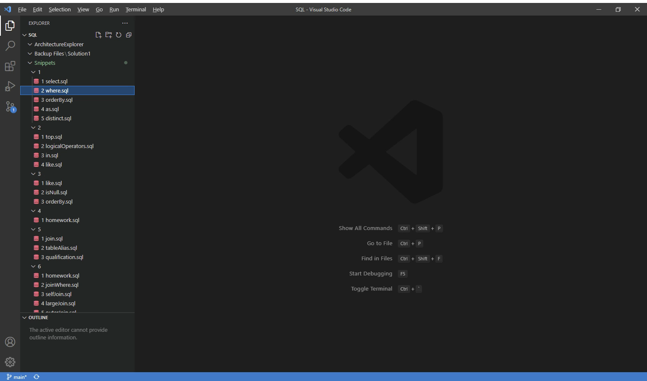
Notes:
One of the things I love about VS Code is the flexibility it gives you to customize it however you want. You can drag and drop practically anything to make it to your liking.

